Slide 1
Fire Detection on Jetson nano

Slide 2
Overview
Problem:
Detecting a fire is often too late and has many serious consequences.
There are many different types of fires and signs of detection. Therefore, it is very difficult for humans to detect with the naked eye.
Solution: The automatic fire detection system will help solve the above problems.

Slide 3
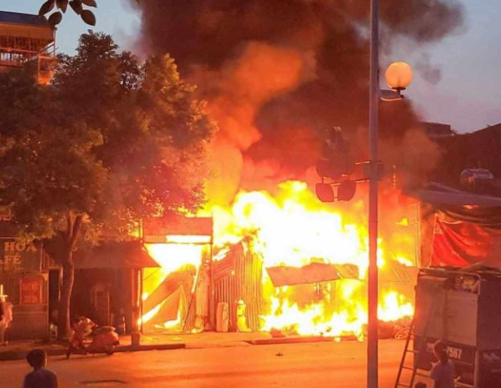


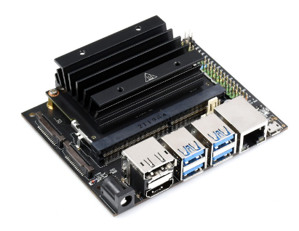
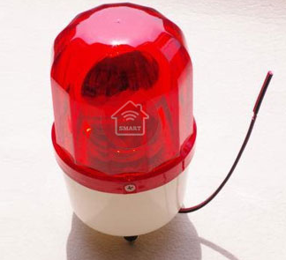
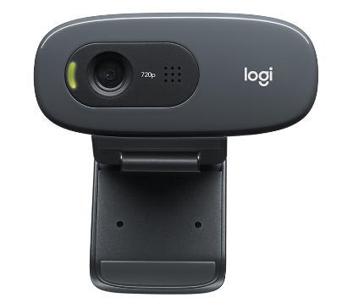
Diagram
Web server
Notification
Wifi
Alarm
Camera
Jetson nano

Slide 4
Workflow
Jetson nano detects fire via camera
Jetson nano turn on alarm
Jetson nano sends message to web server
Web server sends notification to mobile app

Slide 5
AI Model
SSD-Mobilenet is used to re-train following this guideline: https://github.com/dusty-nv/jetson-inference
The training completed after 40 minutes (50 epochs).
Dataset:
1 class (Fire) consist of 300 images.
Images is collected from different real-life fire videos on Youtube.
Label, Annotate and export to VOC format by using Roboflow tool.

Slide 6
Demo
Prerequisites:
Setup the Jetson nano 4GB and camera(Follow by the guideline https://github.com/dusty-nv/jetson-inference).
Use 1 red led to connect to GPIO pin 11. This led is to simulate lid open/close control. When the led light it mean the system dectect a fire.
The model is retrained and exported to Onxx.
Step 1: Navigate to ssd folder: “jetson-inference/python/training/dectection/ssd”. Model file is in : “jetson-inference/python/training/detection/ssd/model/fire”.
Step 2: Open terminal, run “python3 ssd_inference.py”.

Slide 7
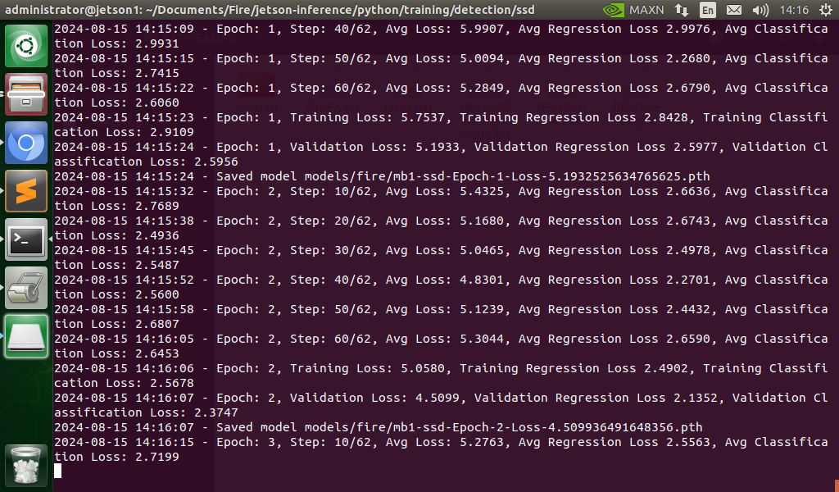
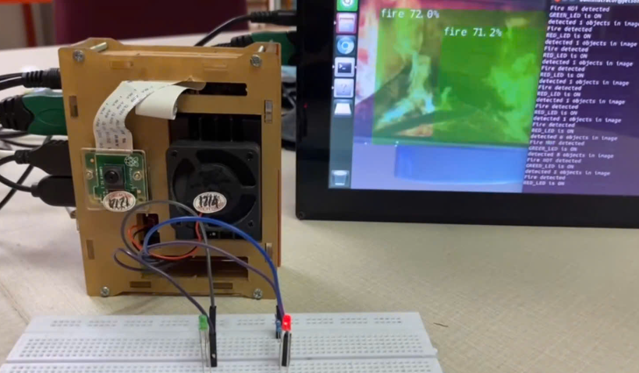
Images
Training process
Demo

Slide 8
Thank you for watching

